Slide 1


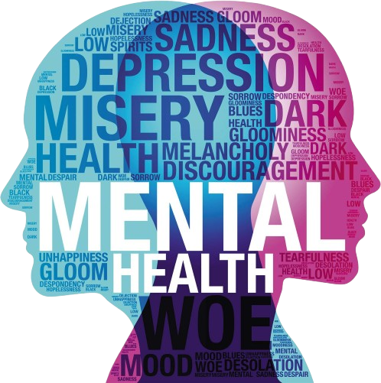

Declining mental health of the younger generation
তরুণ প্রজন্মের মানসিক স্বাস্থ্যের অবনতি
“Your mental health is just as important as your physical health.”

Slide 2
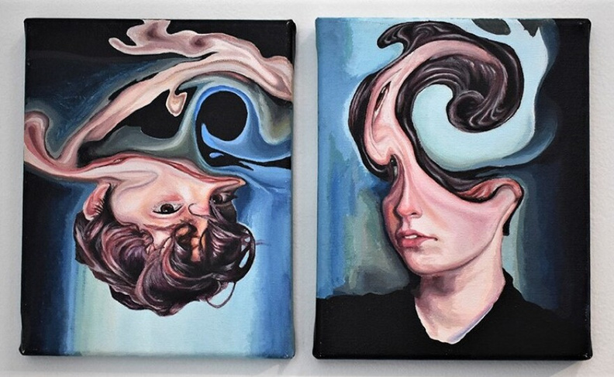
Own Experience
Relevance & Timeliness
Growing Awareness
Connection to Success
Potential for Change

Slide 3




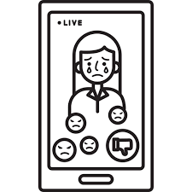

Family Issues
REASONS
Body Image and Perfectionism
Increased Academic Pressure
Social Media and Cyberbullying
Uncertainty About the Future

Slide 4

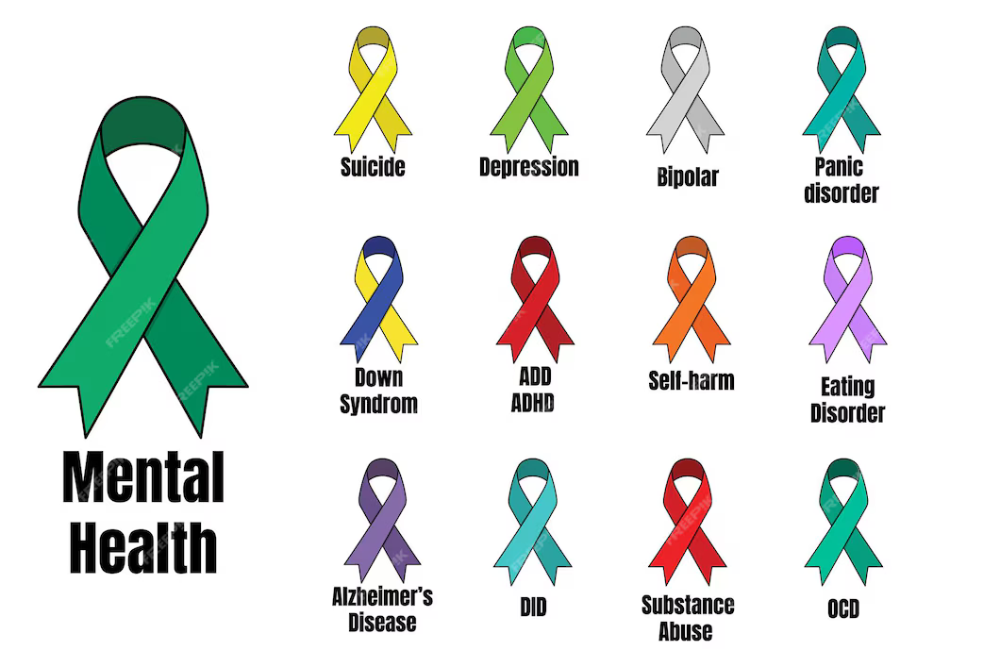
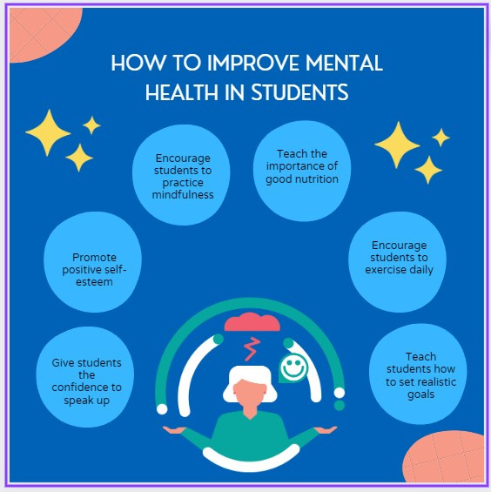

Mental Health awareness month ribbons
How to improve mental Health

Slide 5


“Taking care of your mental health is an act of self-love.”
“There is no shame in seeking help for your mental health.”

